Slide 1
INNOVATE AT SCALE WITH CONFIDENCE POWERING A SECURE AND RESILIENT AI ESTATE
Colm Moynihan, Principal Solution Engineer

Slide 2
The World Is Changing
Findings from a Snowflake study shows, 96% still face significant challenges with data quality and quantity, employee skills, integration with legacy systems, and more.¹
Agents don't just answer questions they
Take actions
Access sensitive data
Make decisions
According to Gartnerⓡ by 2027, 80% of large enterprises will have clearly defined, reusable governance and guardrail practices for their conversational AI agents and assistants.²
According to Gartnerⓡ through 2029, over 50% of successful cybersecurity attacks against AI agents will exploit access control issues, using direct or indirect prompt injection as an attack vector.³
Snowflake study: https://www.snowflake.com/en/lp/radical-roi-generative-ai/
Gartner, Practical AI Security: Managing Web-Based AI Assistants,Nader Henein,25, October 2025.
Gartner, Emerging Tech: The Future of AI Security Is in Securing Agent Actions, Not Prompts, Mark Wan and David Senf, 20 February,2026.
GARTNER is the trademark of Gartner Inc and or its affiliates
Notes:
AI agents are not just accessing your data and systems and responding to questions. They're taking actions and making decisions. And this introduces an entirely new category of security, governance, and trust challenges for organizations to navigate.
Based on the ROI of Gen AI and agents 2026 report, 96% of the surveyed organizations said that they still face significant challenges scaling AI.
And we are only in the early innings of what the security transformation looks like. Gartner predicts that by 2027, 80% of large enterprises will have defined, reusable guardrail practices for their AI agents.

Slide 3
Top Concerns From Security Leaders
Identity and
Access Control
Data Exfiltration and Unauthorized Data Movement
Centralized Visibility
Least privileged access
Access to sensitive data
Single pane of glass
Notes:
We've had several conversations with CISOs and security architects over the past year. And three themes come up consistently.
First: least-privilege access and agent identity. Who is this agent? What is it allowed to do?
Second: data exfiltration and unauthorized data movement. Agents can read data and send it anywhere. Without the right controls, you have the risk of agents exfiltrating data.
Third: centralized visibility. Security teams are struggling to understand the current use of AI within their environment.
This week’s launches directly address these concerns.

Slide 4
Security Investments at a Glance
Proactive enterprise-grade security capabilities for data and AI—built-in, not bolted on
SNOWFLAKE
Cortex AI
Coding Agent
CoCo
Orchestration
Cortex Agent
Business Agent
Snowflake CoWork
Analytics & Predictive Insights
AI Functions & Snowflake ML
Connection
Snowflake Managed MCP Server
Agent Security
Data Security
Platform Security
Prompt Protection
Horizon AI Guardrails
Data Integrity and Encryption
Sensitive Data Protection
Authentication
SSO / Provisioning
Agent Identification
Agent Identity
Data Egress
Data Exfiltration Protection
Authorization
RBAC / ABAC
AI Posture
AI Security Package
Data-Leak Prevention
Ransomware Protection
Secure Boundary
Network Security
Trust Center – Security Posture
Horizon Catalog
Notes:
At Snowflake, our goal is to provide proactive enterprise grade security for data and AI that is built in, not bolted on
At the core is platform security — authentication, RBAC, network policies. That's been Snowflake's strength for years.
On top of that is data security — sensitive data protection, encryption, data integrity. Today we are expanding that to data exfiltration and ransomware protection.
And now we've introducing: agent security — purpose-built controls for the agentic era. This includes Agent Identity, Horizon AI Guardrails, AI Security Posture Management in Trust Center.

Slide 5
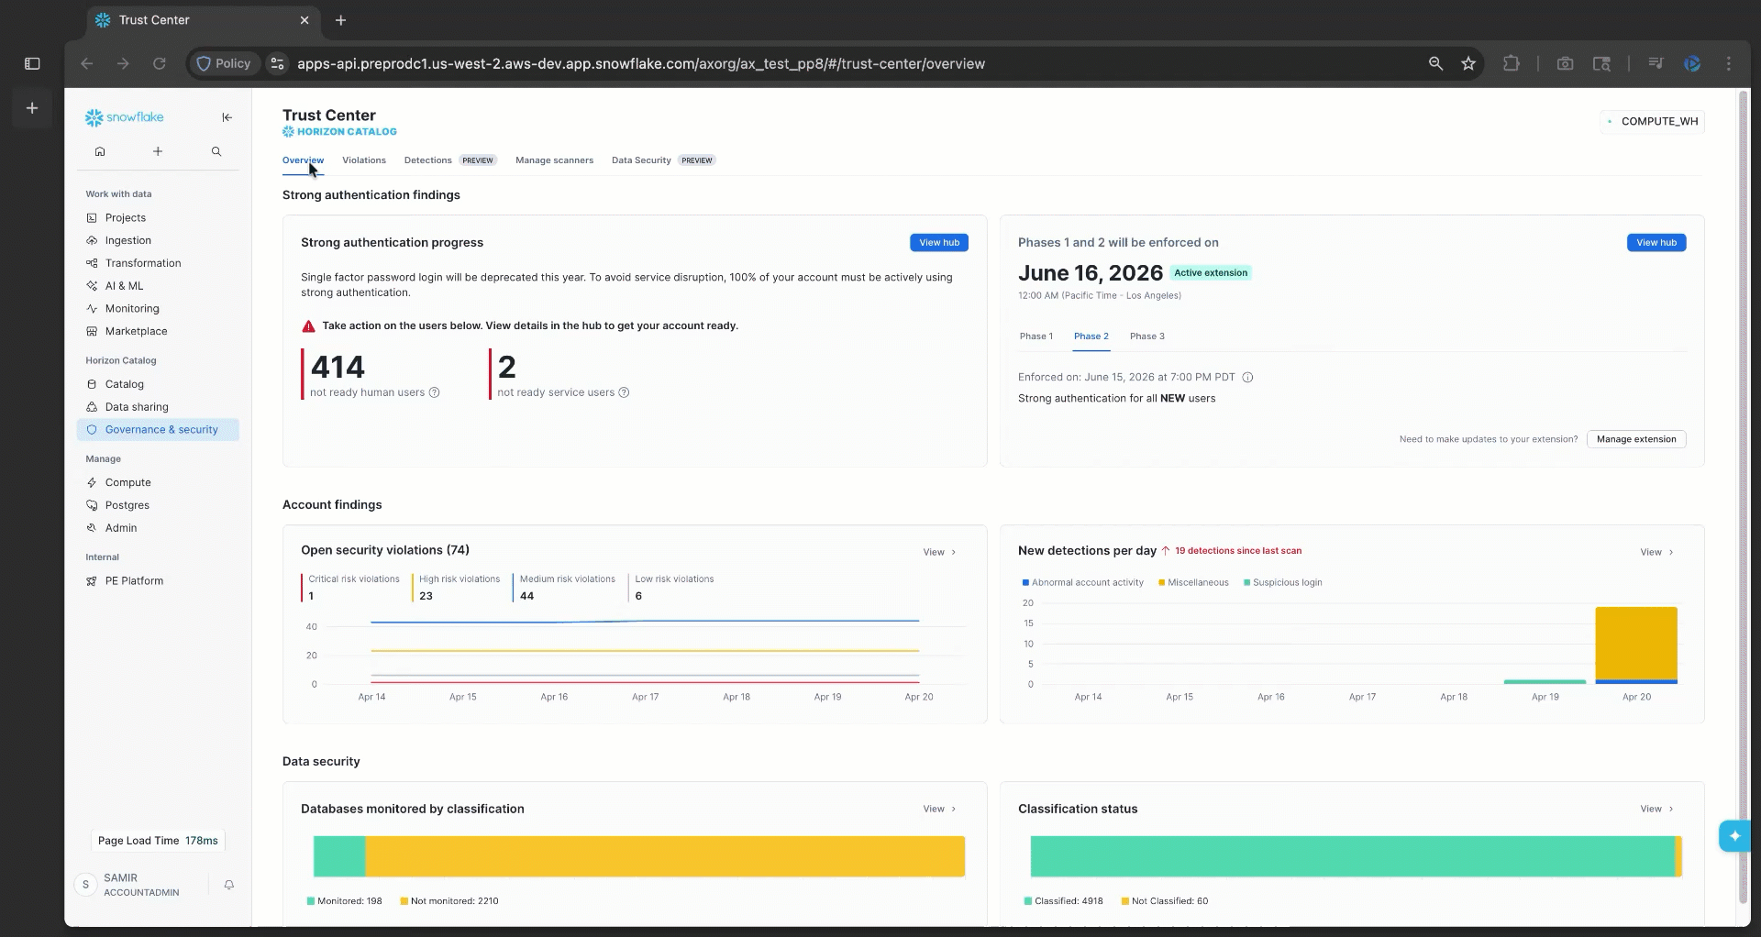
Trust Center
WHAT IS IT
Discover & remediate security, identity, data governance, and compliance risks
Streamline cross-cloud security monitoring in one centralized place Lower TCO and reduce account risks
Scan accounts to detect security violations based on Snowflake CIS Benchmark
WHY USE IT
HOW TO USE IT
Notes:
[Talk track from cut slide — Trust Center Evolution]
When we launched, it was about surfacing violations and manual remediation.
Today, we've moved from violations to near real-time detections, manual remediation to AI-assisted remediation, and SSPM and DSPM to AI Security Posture Management and data exfiltration, security and governance to compliance.
Trust Center is Snowflake's single pane of glass giving you visibility into security, compliance and governance across accounts, across clouds.
It scans your accounts against the Snowflake CIS Benchmark — industry best practices for Snowflake security configuration. And surfaces the violations. And critically, it tells you what to do about them. Now that’s where we started.
Over the last year, we have significantly expanded Trust Center.

Slide 6
DEMO

Slide 7
THANK YOU

